Slide 1
Spring Data REST: Getting Started
INTEGRATING AND USING SPRING DATA REST IN AN APPLICATION

Slide 2
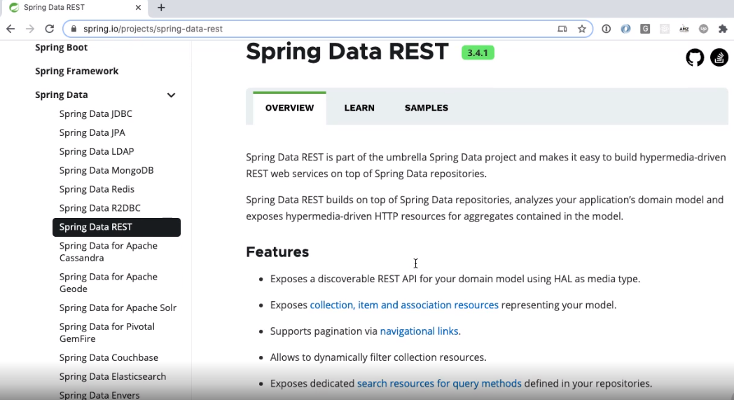

Slide 3



What Can Spring Data REST do?
REST ENDPOINTS
SPRING DATA REST
speakers
@Entity @Table
speaker_id first_name last_name
...
Interface
Speaker
SpeakerJpaRepository
PostgreSQL
Spring App
UI

Slide 4

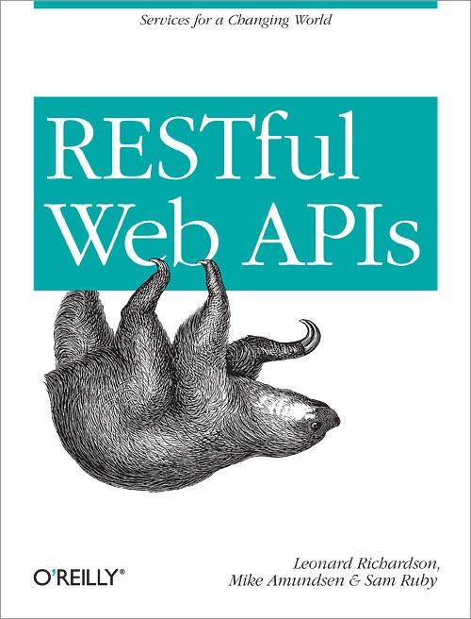

REST Overview
Hypermedia
3 HATEOAS
2 - Verbs
1 - Resources
0 - RPC Services

Slide 5
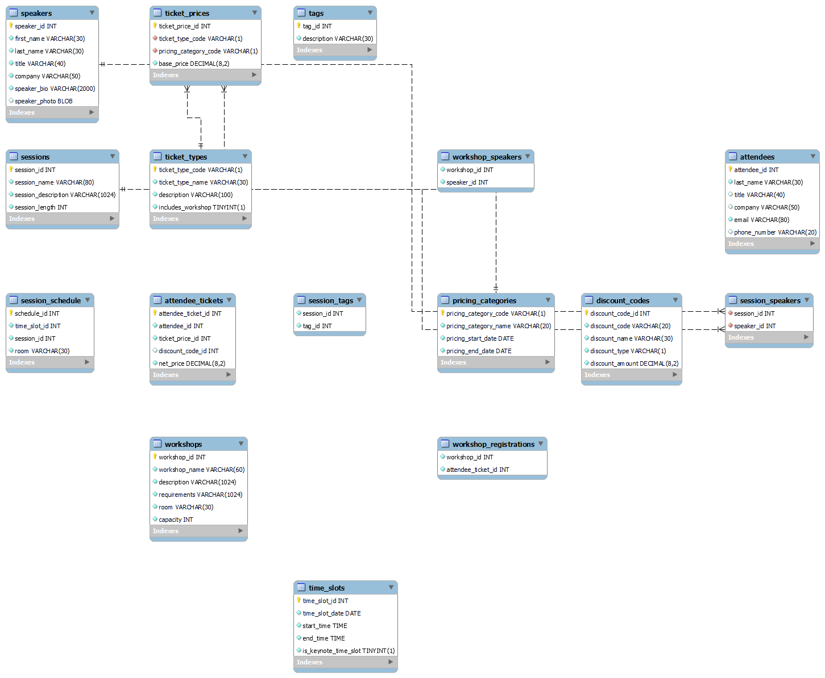
Setting up the Database

Slide 6
<!-- pom.xml - Spring Data REST dependency -->
<dependency>
<groupId>org.springframework.boot</groupId>
<artifactId>spring-boot-starter-data-rest</artifactId>
</dependency>
Integrating Spring Data REST
# application.properties spring.data.rest.basePath=/api

Slide 7
Spring Data REST Ecosystem
JPA
MongoDB
Neo4j
Gemfire
Cassandra
Solr

Slide 8

Summary
What is REST? Project setup
Spring Data REST integration Technologies Spring Data REST supports

